Slide 1
PDAs Accept
Context-Free Languages
Courtesy Costas Busch - RPI

Slide 2

Theorem:
Context-Free
Languages
(Grammars)
Languages
Accepted by
PDAs
Courtesy Costas Busch - RPI

Slide 3
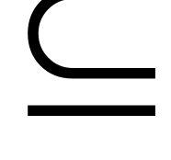



Proof - Step 1:
Context-Free
Languages
(Grammars)
Languages
Accepted by
PDAs
Convert any context-free grammar
to a PDA with:
Courtesy Costas Busch - RPI

Slide 4

Proof - Step 2:
Context-Free
Languages
(Grammars)
Languages
Accepted by
PDAs
Convert any PDA to a context-free
grammar with:
Courtesy Costas Busch - RPI

Slide 5
Convert
Context-Free Grammars to
PDAs
Proof - step 1
Courtesy Costas Busch - RPI

Slide 6


Take an arbitrary context-free grammar
We will convert to a PDA such that:
Courtesy Costas Busch - RPI

Slide 7


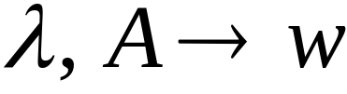
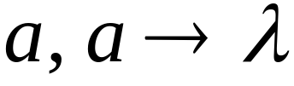
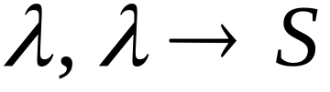




Conversion Procedure:
For each
For each
production in
terminal in
Add transitions
Courtesy Costas Busch - RPI

Slide 8
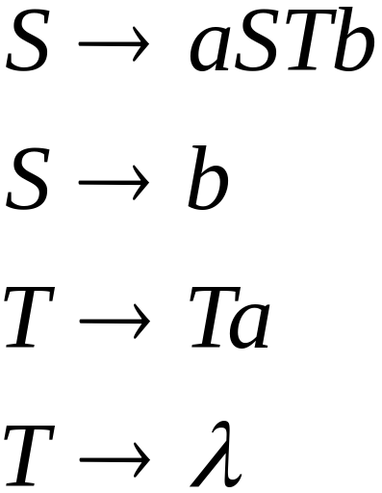
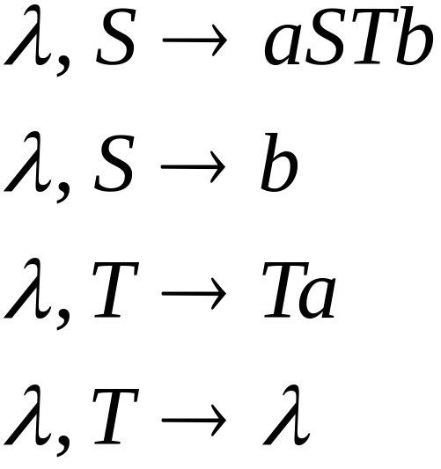
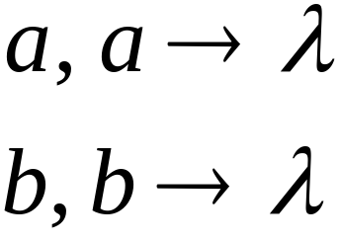
Example
Grammar
PDA
Courtesy Costas Busch - RPI

Slide 9


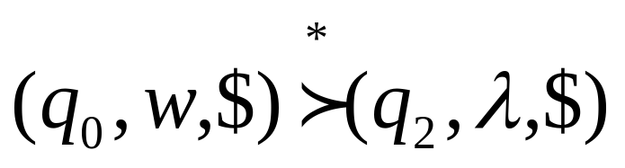
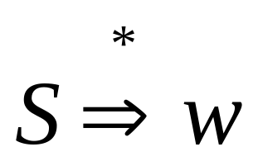
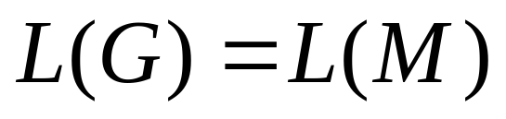
In general, it can be shown that:
Grammar
generates
string
If and
Only if
PDA
accepts
Therefore
Courtesy Costas Busch - RPI

Slide 10
Convert
PDAs to
Context-Free Grammars
Proof - step 2
Courtesy Costas Busch - RPI

Slide 11
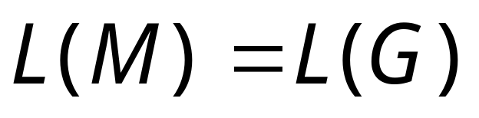
Take an arbitrary PDA
We will convert
to a context-free grammar such that:
Courtesy Costas Busch - RPI

Slide 12
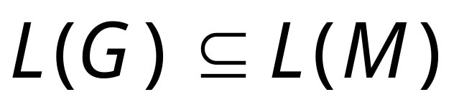
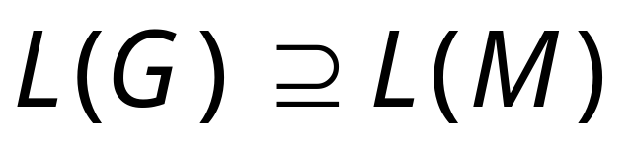
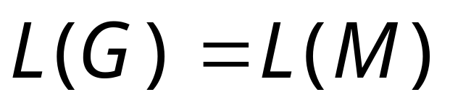
So far we have shown:
With a similar proof we can show
Therefore:
Courtesy Costas Busch - RPI

